Slide 1

Name :- Car Price Prediction Project.
Submitted by:-
AKSHAY DINESH SHAH

Slide 2
Problem Statement
With the covid-19 impact in the market, we have seen lot of changes in the car market. Now some cars are in demand hence making them costly and some are not in demand hence cheaper.
The price of the car varies depending on many factors and even the resale price of the car. This study is intended on building a machine learning model which predicts the resale prices of cars.
Since, the sales of cars coming back to pace, this model helps the traders to valuate the resale price offered and make a decision. This model is built with the recently collected data from the popular cities of India.

Slide 3
The Dataset
The data for this study is collected from the online used car trader CARS24.
The BeautifulSoup & Selenium library is used for the scraping process. After the scraping process is complete.
The training set contains the features, along with the price of the various used cars. It contains 12 input features and 1 output column — ‘Price’.
The data consisted of 5 popular cities which are New Delhi, Chennai, Hyderabad, Bangalore and Mumbai.

Slide 4
Features
1. Car Name
2.Price
3.EMI
4.Features
5.Location
6.Car Brand
7.Model
8.Model Year
9.Gear
10.Driven (Kms)
11.Ownership
12.Fuel
13.EMI (monthly)

Slide 5
Content
Exploratory Data Analysis (EDA):
Analysing Target Variable(‘Price’)
Analysing Feature columns:
Label Encoding
Correlation
Outliers Detection and Skewness
Scaling the data — Standard scaler
Principle Component Analysis
Model Building
Cross Validation
Hyper Parameter Tuning
Saving

Slide 6
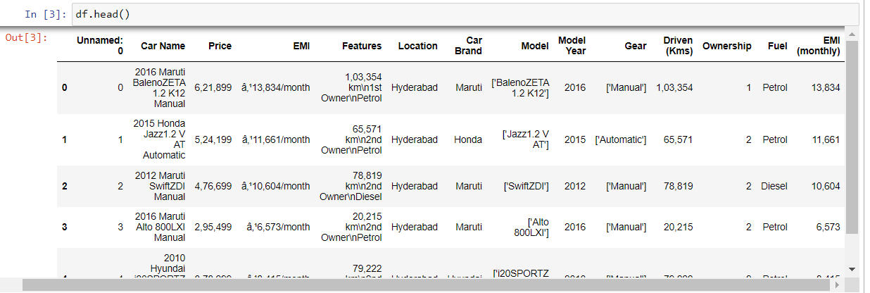
Loading Dataset

Slide 7
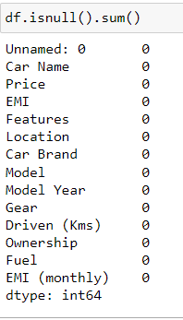
We further proceed to explore the dataset.
Checking data types in each columns, we observe that maximum number of columns are object type, only ‘model year’ , ‘EMI (monthly)’ is int type.
We now check the count of Nan (null) values in our dataset, which turns out to give the following result –
We have NO null values.

Slide 8
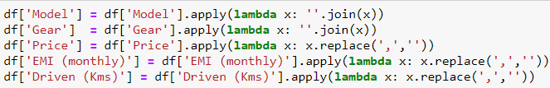
Cleaning the format of different columns
Data Cleaning
Removing unwanted columns & rearranging wanted columns

Slide 9
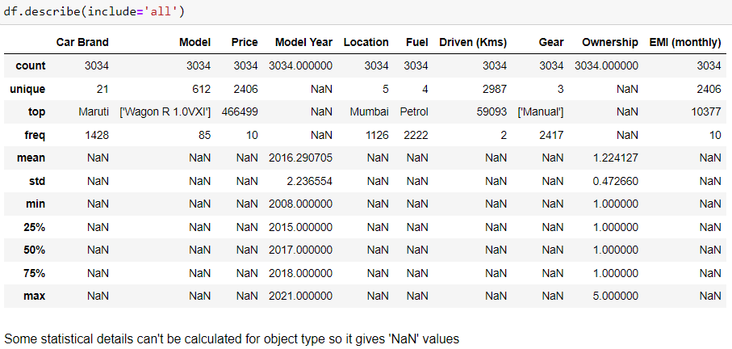
Getting the basic summary and statistical information of the data.
.

Slide 10
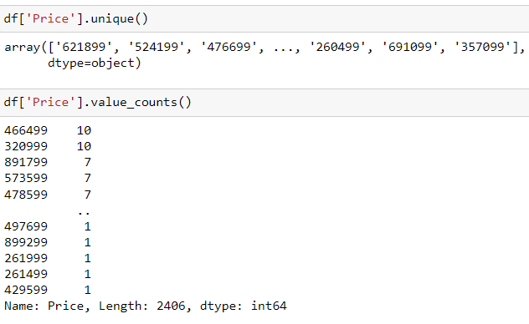
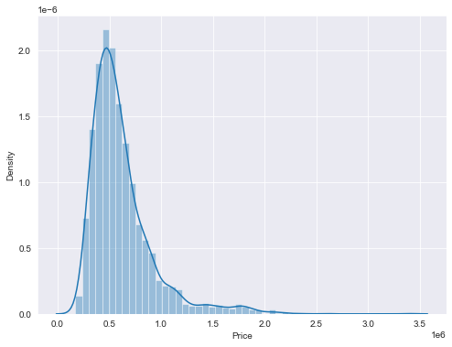
We now start exploring the columns available in our dataset.
Analysing Target Variable(‘Price’) :

Slide 11
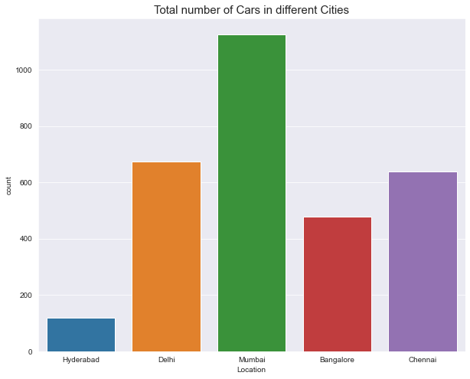
Analysing Feature columns:
Total number of cars in different Cities
Mumbai 1126
Delhi 674
Chennai 638
Bangalore 478
Hyderabad 118

Slide 12
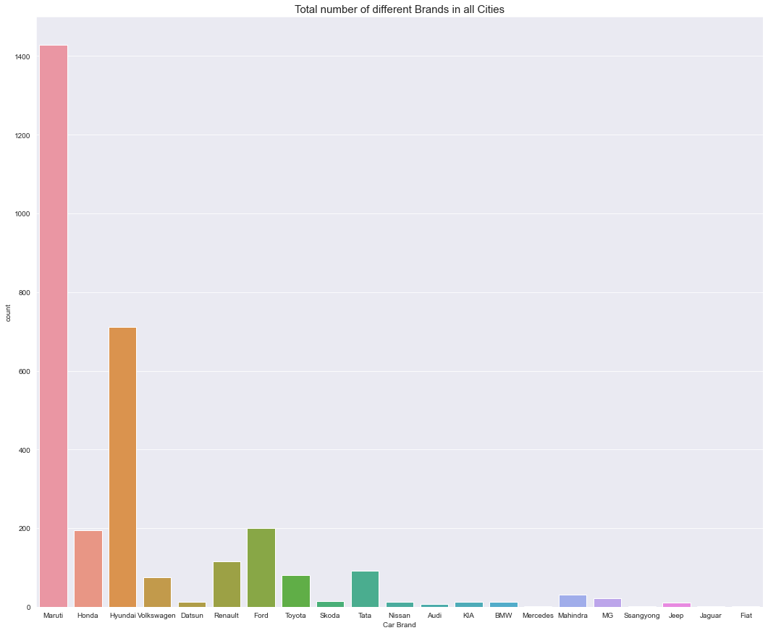
No. of different Brands in all Cities
Maruti 1428
Hyundai 711
Ford 200
Honda 194
Renault 115
Tata 91
Toyota 80
Volkswagen 75
Mahindra 30
MG 22
Skoda 14
Datsun 13
KIA 13
BMW 13
Nissan 12
Jeep 11
Audi 7
Mercedes 2
Jaguar 1
SsangYong 1
Fiat 1

Slide 13
Total number of different Brands in all Cities’:-

Slide 14
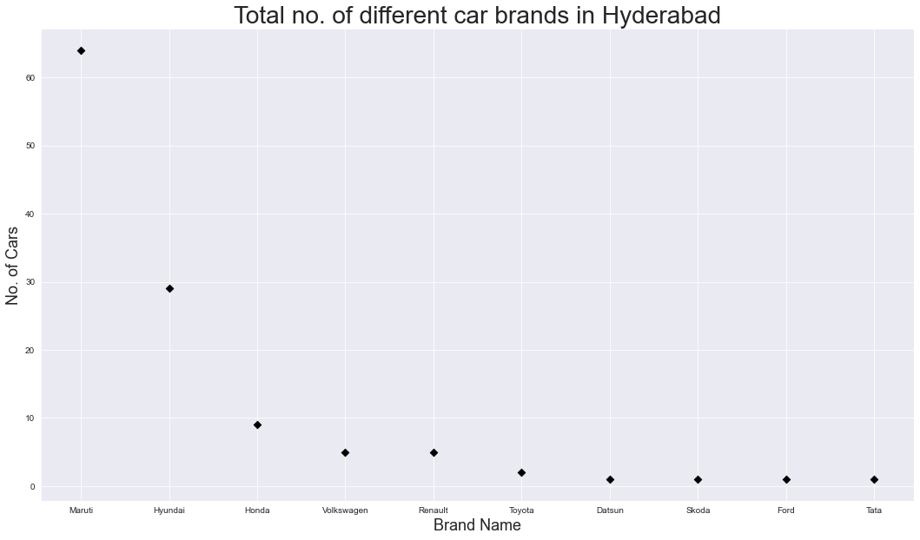
Total no. of different Car Brands in Hyderabad

Slide 15

Total no. of different Car Brands in Delhi

Slide 16
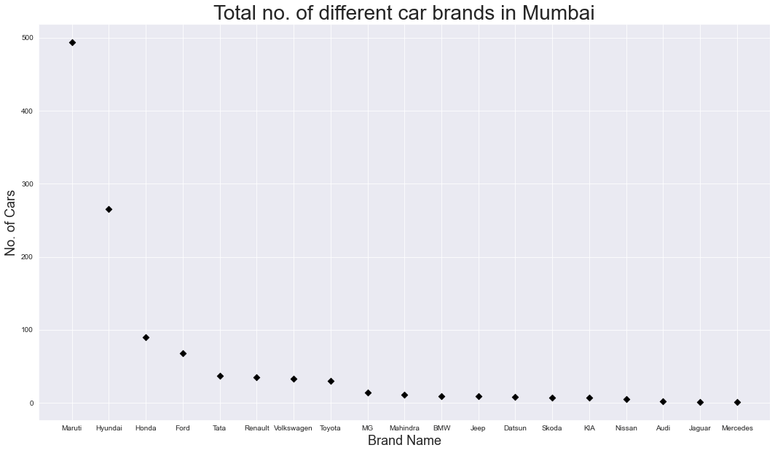
Total no. of different Car Brands in Mumbai

Slide 17
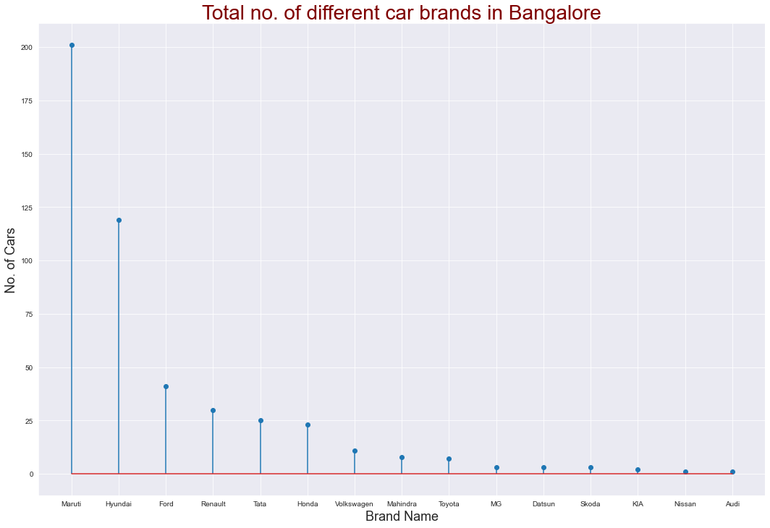
Total no. of different Car Brands in Bangalore

Slide 18
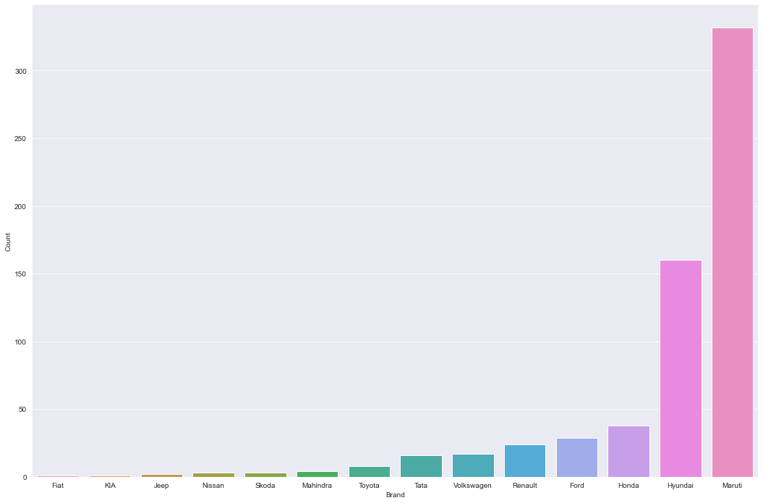
Total no. of different Car Brands in Chennai

Slide 19
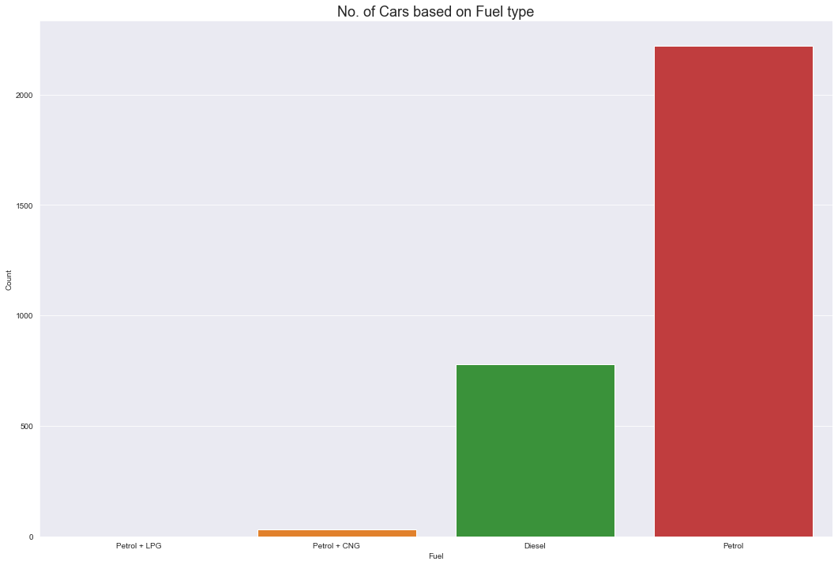
Number of Cars based on Fuel type in all cities

Slide 20
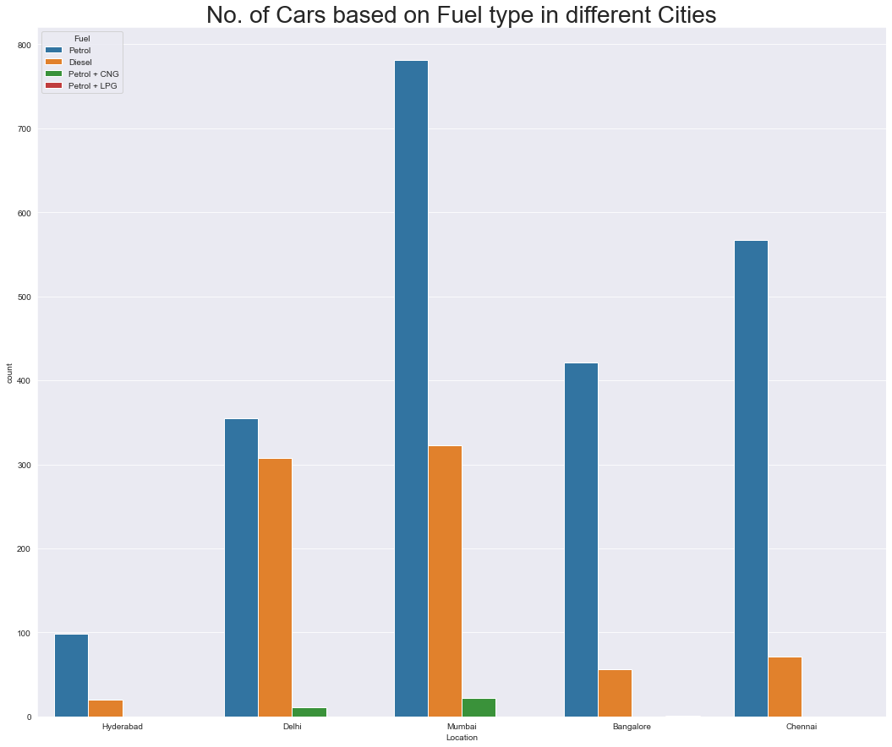
No. of Cars based on Fuel type in different Cities

Slide 21
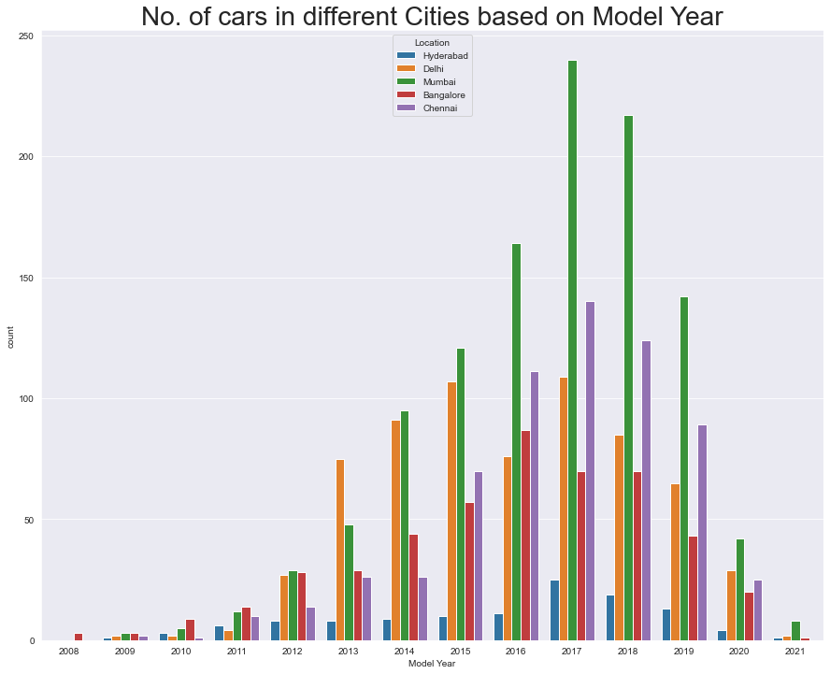
No. of cars in different Cities based on Model Year

Slide 22
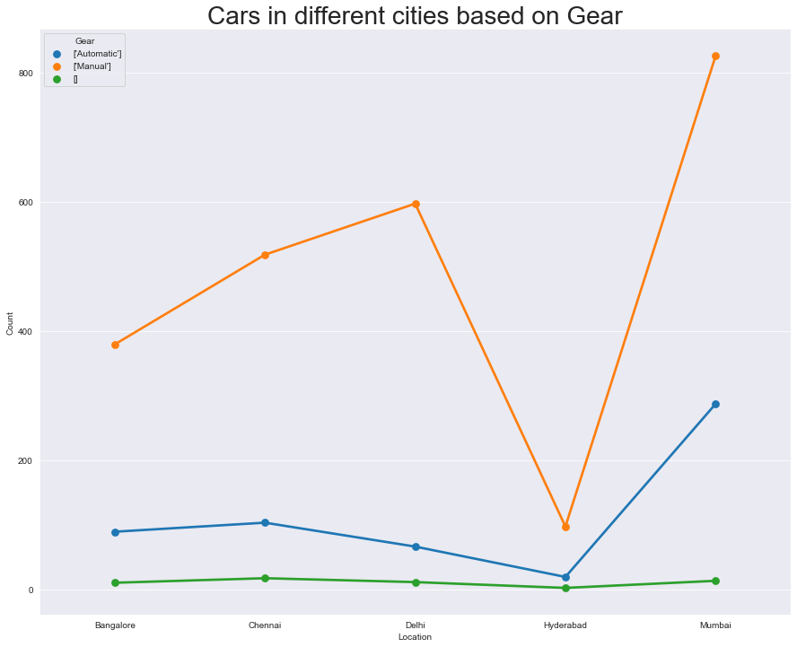
No. of Cars in different cities based on Gear

Slide 23
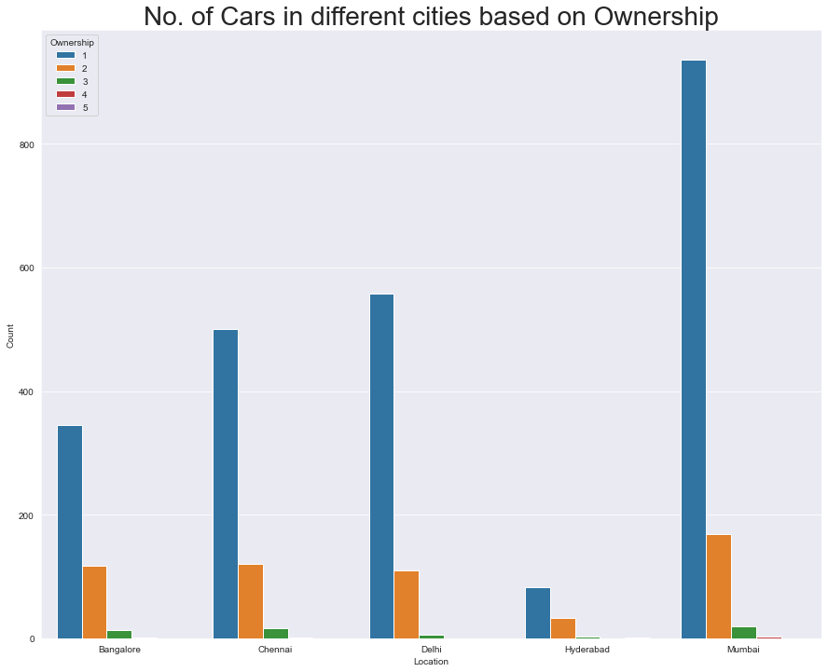
No. of Cars in different cities based on Ownership

Slide 24
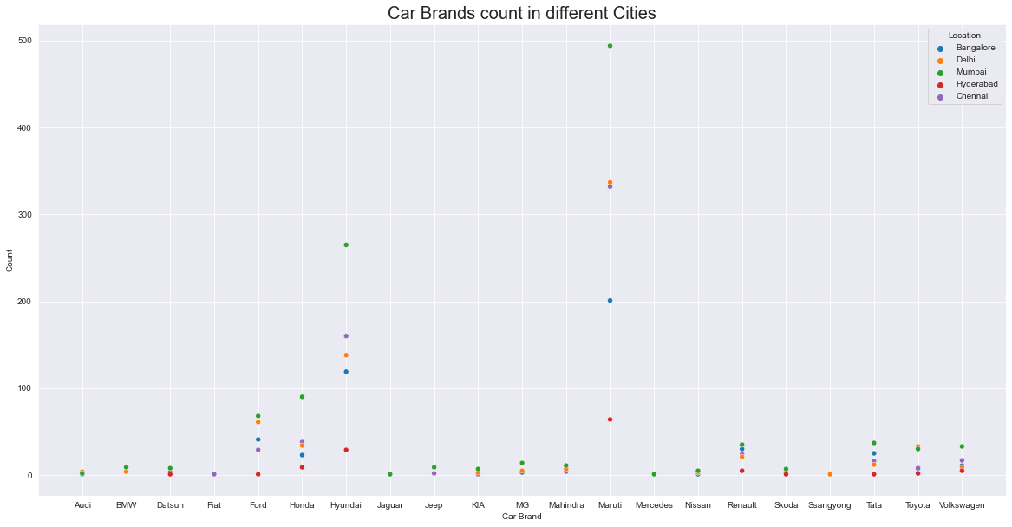
Comparision of car brand count in different Cities

Slide 25
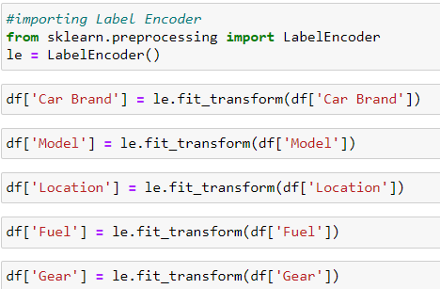
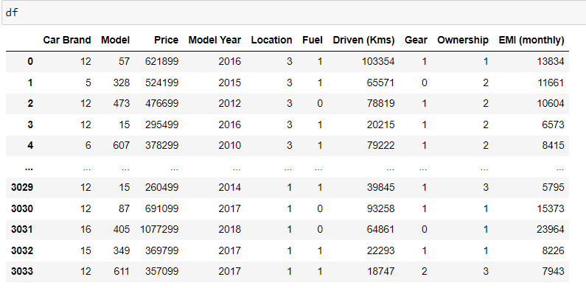
Label Encoding:-
We encode the categorical data in this step, to convert it to integer type, since the model does not work on ‘string’ data. We use ‘Label Encoder’ to achieve the desired results.
Now encoded data looks like

Slide 26
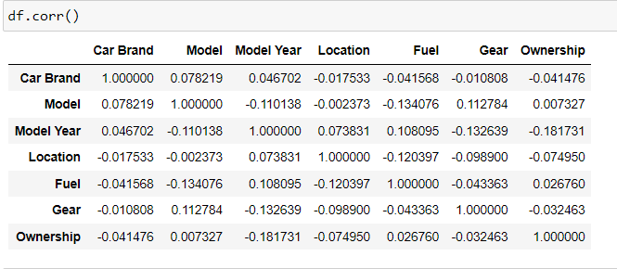
Correlation

Slide 27
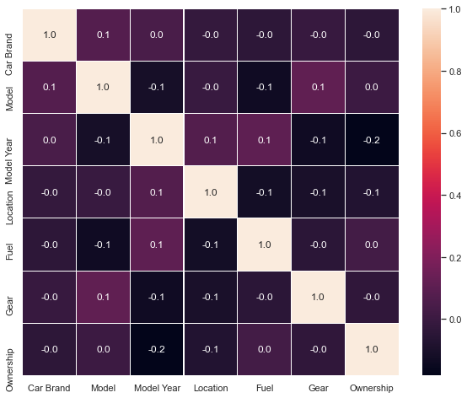
Heat Map

Slide 28
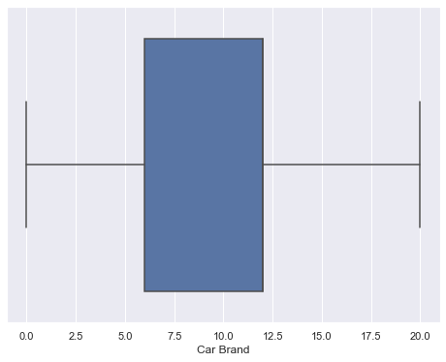
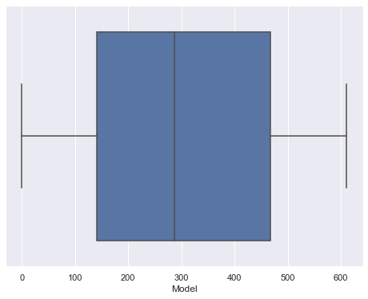
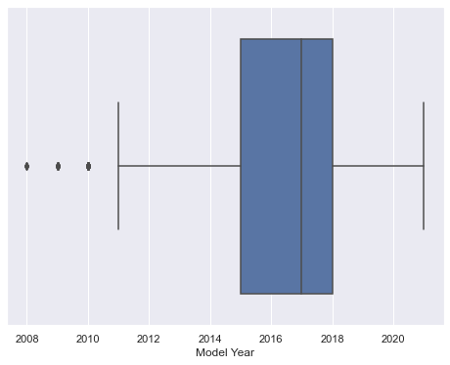
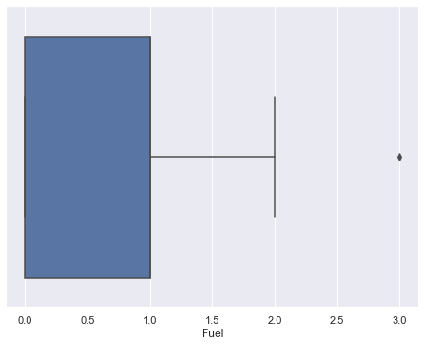
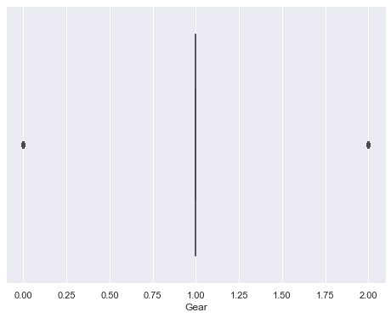
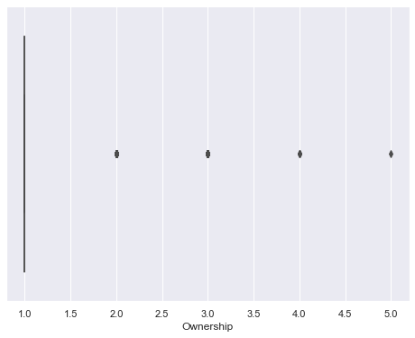
Checking for Outliers
We now plot boxplots to check the presence of outliers in our data –

Slide 29
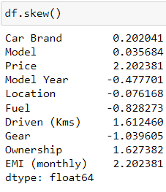
Conclusions:
We make the below conclusions –
- Outliers are present in Ownership','Gear','Model Year’
- We will not remove outliers using zscore method –
Checking for Skewness:- We now proceed with treating skewness in our data, which allows us to fit our data in a symmetric distribution, which further allows our model to learn better.

Slide 30
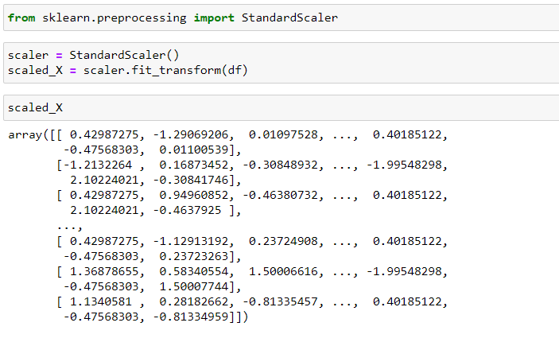
Standard Scaler Method:
The next step is to bring the data to a common scale, since there are certain columns with very small values and some columns with high values. This process is important as values on a similar scale allow the model to learn better.

Slide 31
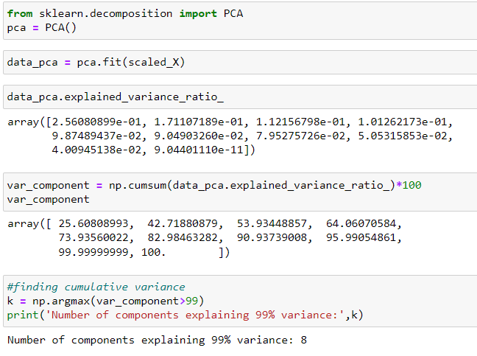
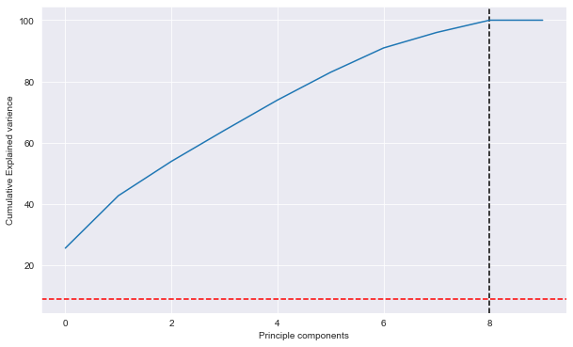
Principle Component Analysis:
Principal component analysis (PCA) is a very popular technique used for dimensionality reduction. learning technique used for transforming data.

Slide 32
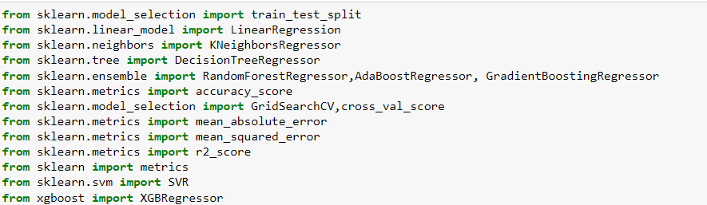
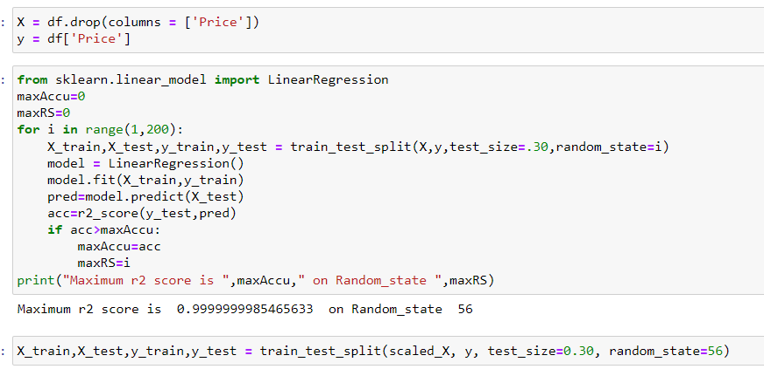
Module Building
We now proceed to the main step of our machine learning, fitting the model and predicting the outputs. We fit the data into multiple regression models to compare the performance of all models and select the best model.
Splitting Data
Importing Libraries:-

Slide 33
Analysing Model Accuracies:-
Linear Regression
R2_Score: 1.0
MAE: 2.4620267386372026e-10
MSE: 9.799637034810563e-20
RMSE: 3.1304371954745493e-10
DecisionTreeRegressor:-
R2_Score: 0.9835683436467052
MAE: 2749.2105855855857
MSE: 1766944785.1362612
RMSE: 42035.04234726381

Slide 34
KNeighborsRegressor:-
R2_Score: 0.8429284982891683
MAE: 85010.69707207207
MSE: 16890364846.622747
RMSE: 129962.93643428787
RandomForestRegressor:-
R2_Score: 0.9843984690010383
MAE: 2530.5822072072074
MSE: 1677678941.552928
RMSE: 40959.47926369338
AdaBoostRegressor:-
R2_Score: 0.978032756231073
MAE: 23486.08486689315
MSE: 2362202932.362304
RMSE: 48602.499239877616

Slide 35
XGBRegressor:-
R2_Score: 0.9862582734370778
MAE: 4017.365938203829
MSE: 1477688649.7054315
RMSE: 38440.716040488
SVR:-
R2_Score: -0.08595045212027808
MAE: 210364.2432202676
MSE: 116775475766.66196
RMSE: 341724.26862407936
GradientBoostingRegressor:-
R2_Score: 0.9873620759126852
MAE: 3685.7717838249187
MSE: 1358993492.8593624
RMSE: 36864.52892496203

Slide 36
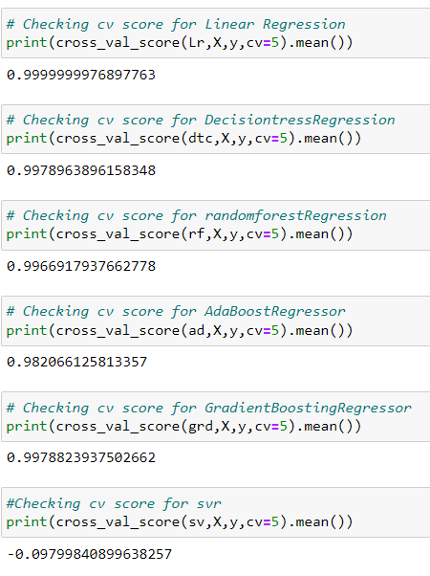
Cross Validation
We perform the cross validation of our model to check if the model has any overfitting issue, by checking the ability of the model to make predictions on new data, using k-folds.
Based on comparing Accuracy Score results with Cross Validation results, it is determined that RandomForestRegressor is the best model.

Slide 37
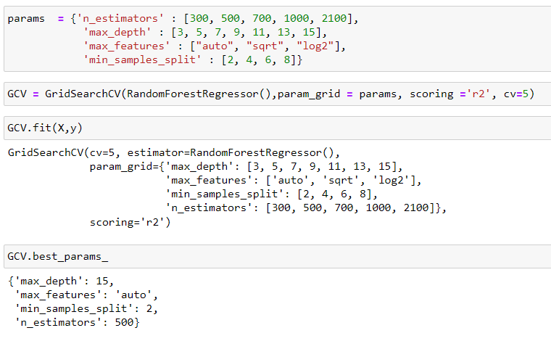
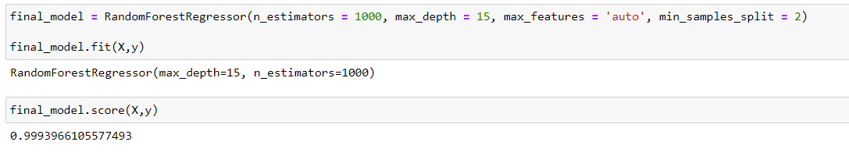
Hyper Parameter Tuning
GridSearchCV is used for Hyper Parameter Tuning of the RandomForestRegressor model.
Based on the input parameter values,
The RandomForestRegressor Model was further tuned based on the parameter values yielded from GridsearchCV.

Slide 38
The r2_score received for RandomForestRegressor comes out to be better after hyper tuning.
Hence we select RandomForestRegressor as our final model, save the model using best parameters, and create model object using joblib.

Slide 39
Hence ,we have trained our regression model.
‘RandomForestRegressor’ is the best model to predict the price of used cars on cars24.com.
THANK YOU

